Slide 1

HR ATTRITION ANALYSIS (MeriSKILL Internship Project 3)
JOY CHINENYE AKOUWA

Slide 2
Project analysis slide 3
Project Outline
Introduction
Objective
Dashboards
Insights
Conclusion and Recommendation

Slide 3
Project analysis slide 5
Introduction
Understanding and reducing employee attrition is crucial for promoting organizational sustainability and success in the ever changing field of Human Resources. The Human Resources Attrition Analysis that is provided here explores the complex aspects of employee turnover in the company with the goal of revealing the underlying causes, spotting trends, and offering practical advice, This analysis aims to measure attrition and more crucially, to understand the why and how of employee exit by examining the nuances of employee departure. We want to customize strategic interventions that go beyond simple retention efforts, creating an environment at work that fosters longevity, engagement, and professional fulfilment.
We focus on gender, age, department, and job involvement.
This analysis serves as a compass, directing the development of focused HR strategies that complement the goals of the employees and guarantee a robust, involved, and prosperous organizational community.

Slide 4

Project analysis slide 4
Objective
The Objective of this HR Attrition Analysis is to thoroughly examine and understand the patterns, causes, and implications of employee turnover within an organization.
It seeks to delve into the world of human resources, with a keen eye on data analysis to optimize talent management and organizational performance. Studying intricacies of why employee leave. By doing so, organizations can make informed decisions, implement targeted strategies, and cultivate a work environment that promotes employee satisfaction, engagement, and longevity.

Slide 5
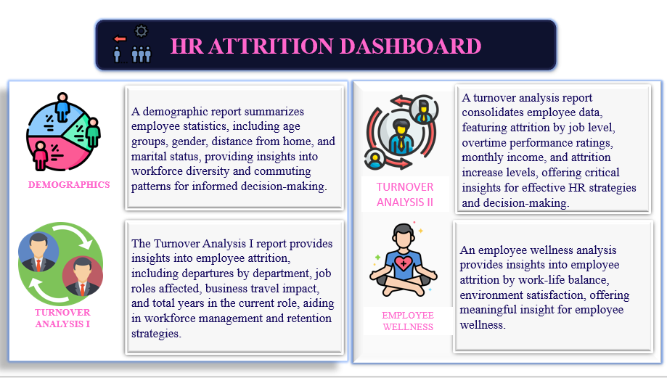
Project analysis slide 6
Dashboards

Slide 6
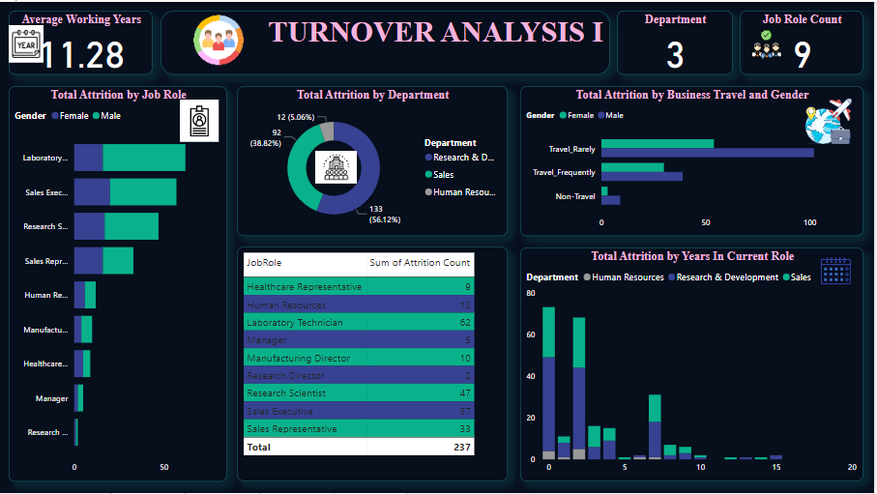
Project analysis slide 7
Dashboard

Slide 7
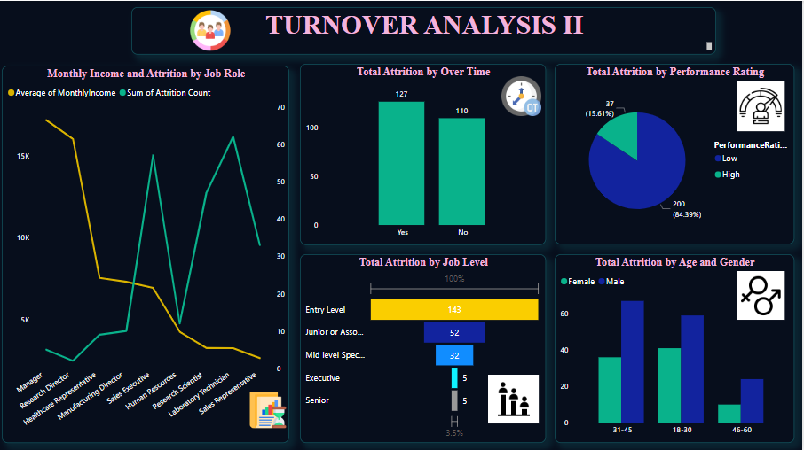
Project analysis slide 8
Dashboard

Slide 8
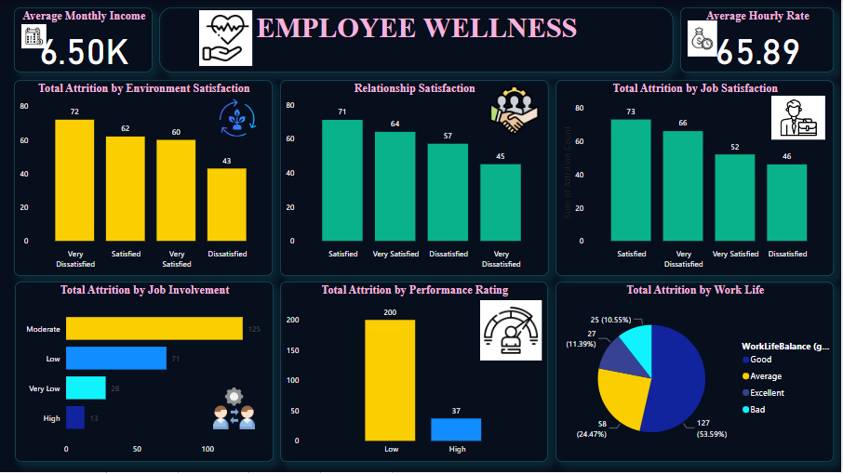
Project analysis slide 10
Dashboard

Slide 9
Project analysis slide 11
Insights
Demographics
Turn Over Analysis I
This report summarizes employees statistics which includes: Total employees which is 1470 employees.
Active employees is 1233.
Attrition Count 237, which is 16% average of active employees. Male Attrition rate is150 which is 63.29% and is higher than Female Attrition rate which is 87 which is 36.7%.
Total Attrition by age shows that more workers within ages 31-45 left the company.
Employees whose Educational Field was Life Sciences had more attrition at 606 while Human Resources at 27 had the least attrition.
Total Attrition by Work Life Balance shows that employees who had a good work life balance left the company.
In Total Attrition by Marital Status the attrition had more single employees especially male.
Total Attrition by Distance from Home where most employees that lived close to the workplace exited the company more.
The Turnover Analysis provides insights into employees attrition which includes:
Average Working Years is 11.28 years
Total Attrition by Business Travel and Gender employees who rarely travelled especially male had more attrition than employees who frequently travelled those who did not travel
Total Attrition by Job Role showed that more employees whose job role was Laboratory Technician had more attrition
Total Attrition by Department 56.12% of employees who worked in the Research and Development department had more attrition compared to employees who worked in Sales and Human Resources which had 38.82% and 5.06% respectively.

Slide 10
Insights
Turn Over Analysis II
Employee Wellness
The Turnover Analysis provides insights into employees attrition which includes:
Total Monthly Income at $17,181,68, Manager had the highest Average Monthly Income and was 554.29% higher than Sales Representatives , which had the lowest Average Monthly Income at $2,626,00
Total Attrition by Over Time sum of attrition count for Yes (127) was higher than No (110)
Total Attrition by Performance Rating employees with low performance rate of 83.39% had more attrition
Total Attrition by Job Level Entry-level employees at 143 had more attrition than other job levels
Total Attrition by Age and Gender Male employees within ages 31-45 and Females employees within ages 18-30 had more attrition by age and gender
The Employee Wellness report features:
Average Monthly Income of the Employees is $6.50K
Average Hourly Rate is 65.89 hours
Total Attrition by Environment Satisfaction at 72, Very dissatisfied employees had the highest sum of attrition count and was 67.44% higher than Dissatisfied employees which had the lowest sum of attrition at 43
Total Attrition by Relationship Satisfaction at 71, Satisfied employees had the highest sum of attrition count compared to Very Dissatisfied which had the lowest attrition count at 45
Total Attrition by Job Satisfaction employees with Satisfied Job Satisfaction at 73 had the highest sum of attrition count than employees who were Dissatisfied at 46
Total Attrition by Job Involvement employees with Moderate job involvement had the highest attrition count while those with High job involvement had the lowest attrition count
Total Attrition by Work Life at 127 (53.59%) those with Good work life balance had the highest sum of attrition

Slide 11
Recommendation
Based on the HR Attrition Analysis, several key areas need attention to improve employee retention and overall workplace satisfaction:
Considering that entry-level workers have the highest attrition rate, it is important to develop targeted retention measures specifically for them. Encourage dedication by putting in place mentorship programmes, training initiatives, and career growth possibilities.
Implement gender-specific initiatives to address the higher attrition rate among male employees. The factors contributing to male attrition should be recognized and initiatives should be designed to raise employee engagement and job satisfaction.
Investigate the reasons for the attrition in the Research and Development department. Steps should be taken to enhance the work-life balance, career growth and job satisfaction of this department’s staff members.
Develop programmes to keep employees that fall into high attrition categories, like male employees (31-45) and female employees (18-30). In order to foster a healthy work environment, attend to their specific requirement and expectations.

Slide 12
Conclusion
In conclusion, the HR Attrition analysis has yielded significant insights into the variables affecting employee attrition. The company ought to give top priority to programs that target particular group of people, like younger workers, men, and employees in particular age ranges. A more focused and efficient strategy will be achieved by adjusting retention tactics according to departmental specifics, age , and gender.
Furthermore, understanding the correlation between job involvement and attrition underscores the importance of establishing an environment at work that encourages employee engagement. By putting these suggestions into practice, the company can lower attrition while also creating a work environment that fosters dedication and long-term employee fulfilment.

Slide 13
Thank You

